Slide 1
Behavioral Patterns
JS Patterns and Anti Patterns
Malte Brockmann, Jun Heui Cho

Slide 2
Outline
Behavior pattern in general
Chain of Responsibility
Memento
Command
Observer
Summary

Slide 3
Behavior Pattern in general
Mainly concerned with the communication between objects.
Describe a process or a flow
encapsulating behavior and delegating of requests
increases flexibility

Slide 4
Chain of Responsibility (CoR)
Avoid coupling between the sender and the receiver of a request.
More than one object have the chance to handle the request.
linear search for a handler

Slide 5

CoR - Participants
Client: initiator of the request
Handler: has an interface for handling the request
http://www.dofactory.com/images/diagrams/javascript/javascript-chain-of-responsibility.jpg

Slide 6
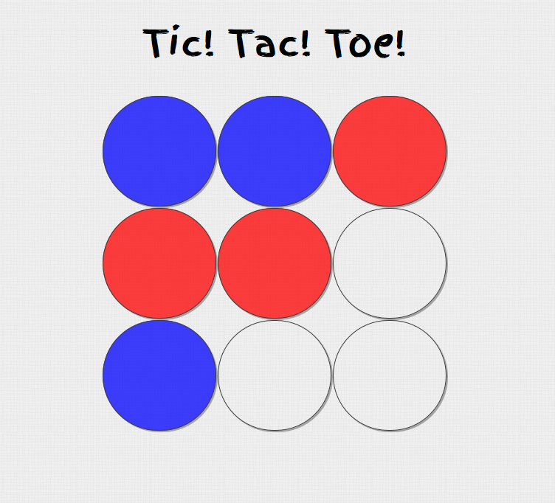
Refactoring: Tic Tac Toe
retro Game
2 player
checks winner or tie after each turn
restarts

Slide 7
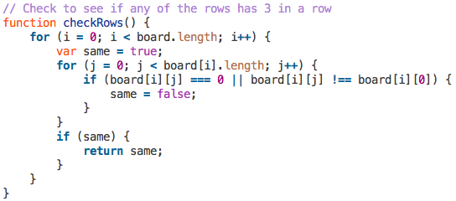
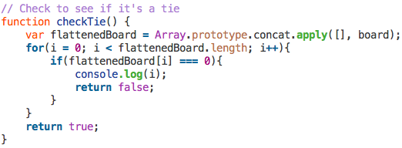
CoR – Tic Tac Toe
before:

Slide 8
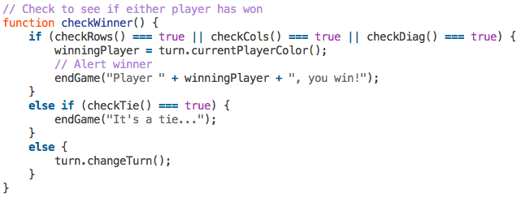
CoR – Tic Tac Toe (cont.)
before:

Slide 9
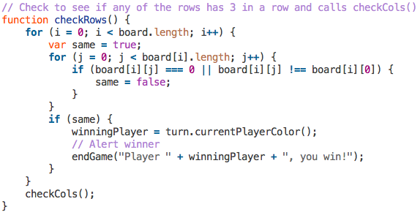
CoR – Tic Tac Toe (cont.)
after:

Slide 10
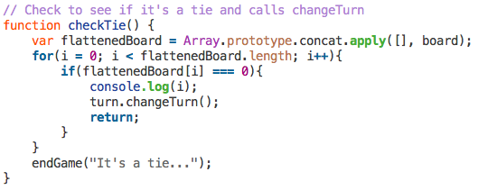
CoR – Tic Tac Toe (cont.)
after:

Slide 11

CoR – Tic Tac Toe (cont.)
after:

Slide 12
CoR – Tic Tac Toe (cont.)
before:
after:
checkWinner()
checkWinner()
checkRows()
checkCols()
checkDiag()
endGame(“Player X, you win!”)
checkRows()
endGame(“Player X, you win!”)
checkTie()
endGame(“Player X, you win!”)
checkCols()
endGame(“Player X, you win!”)
checkDiag()
changeTurn()
endGame(It’s a tie...”)
checkTie()
endGame(It’s a tie...”)
changeTurn()

Slide 13
Memento
Capturing and externalizing an object’s internal state to be restored later.
Database of “save point”
Use: used to avoid disclosure of implementation details

Slide 14
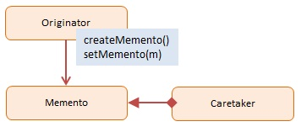
Memento - Participants
Originator: interface to create and restore mementos
Memento: ordinator object
Caretaker: stores mementos
http://www.dofactory.com/images/diagrams/javascript/javascript-memento.jpg

Slide 15
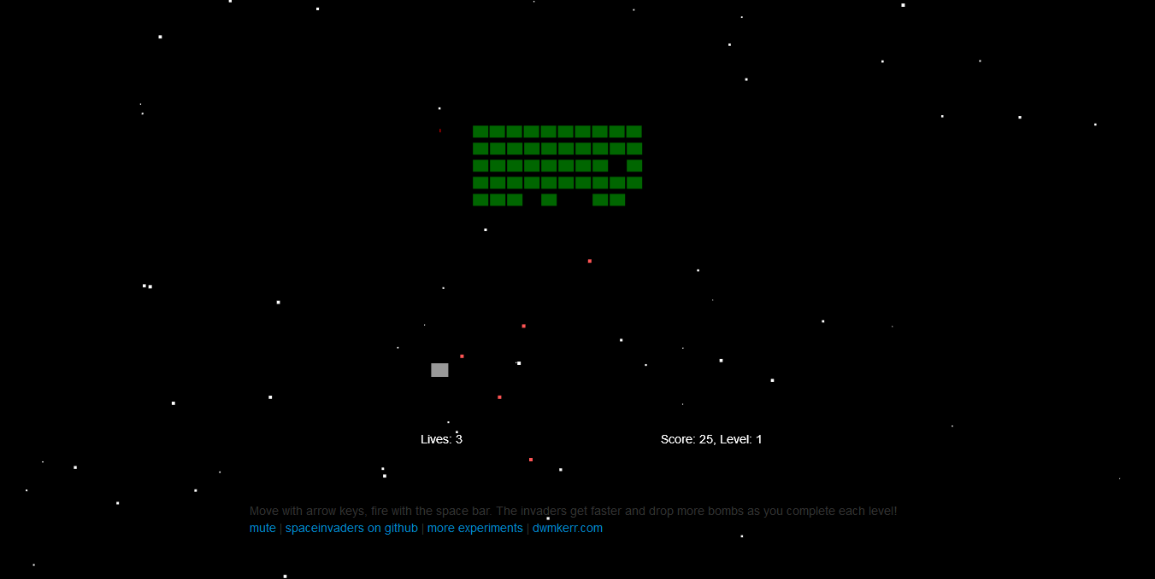
Refactoring: Spaceinvader
Retro Game: shooting Spaceinvader
Level bases
State bases (Welcome-, GameOver-, PlayState, ect.)

Slide 16
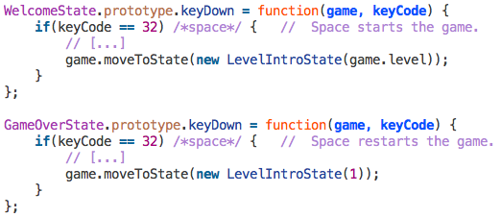
Memento – Spaceinvader
before:

Slide 17
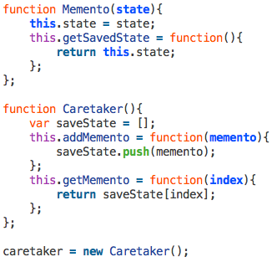
Memento – Spaceinvader (cont.)
after:

Slide 18
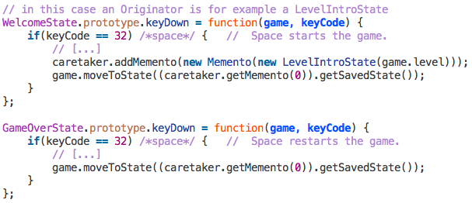
Memento – Spaceinvader (cont.)
after:

Slide 19
Memento – Spaceinvader (cont.)
getMemento(0)
Game
Caretaker
WelcomeState
new created
moveToState( )
Memento
LevelIntroState
LevelIntroState
Memento
GameOverState
...
moveToState( )
LevelIntroState

Slide 20
Command
Encapsulate a request as an object
Request without knowing anything about the operation being requested. - “Black box execute()”
Uses: GUI buttons, Networking, Multi-level undo, Progress bar

Slide 21
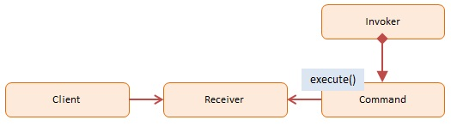
Command - Participants
Client: decides which command at which point
Receiver: knows how to carry out the operation
Command: execute()
Invoker: knows how to execute
http://www.dofactory.com/images/diagrams/javascript/javascript-command.jpg

Slide 22
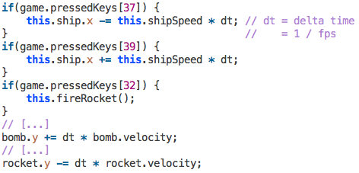
Command - Spaceinvader
before:

Slide 23
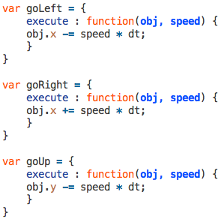
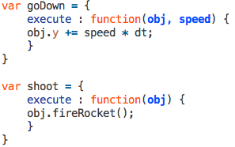
Command – Spaceinvader (cont.)
after: (Commands)

Slide 24
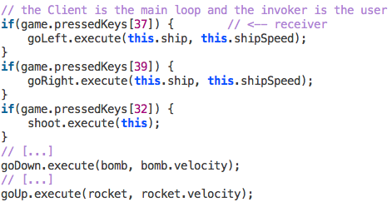
Command – Spaceinvader (cont.)
after:

Slide 25
Observer
Define a one-to-many dependency between objects
When one object (Observable) changes its state, all dependent objects (Observers) are notified (usually with a message)
Notified objects handle their own update

Slide 26
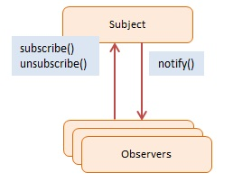
Observer - Participants
Subject / Observable: maintains a list of observers, lets them subscribe/unsubscribe, and notifies them about changes
Observers: has a function that can be invoked when notified
http://http://www.dofactory.com/images/diagrams/javascript/javascript-observer.jpg

Slide 27
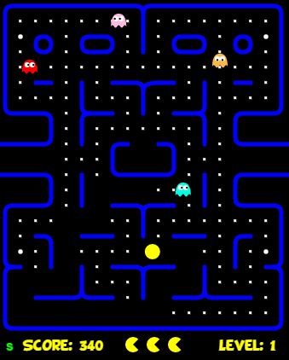
Refactoring: Pac Man
retro game (classic pacman)
3 lives
avoid getting eaten by ghosts
can eat and “jail” the ghosts for a short time after eating “beans”
eat all the blocks to a level

Slide 28
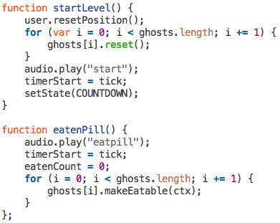
Observer – Pac Man
before:

Slide 29
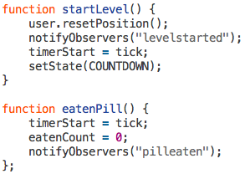
Observer – Pac Man (cont.)
after:

Slide 30
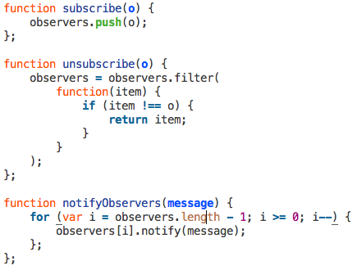
Observer – Pac Man (cont.)
after (Observable):

Slide 31
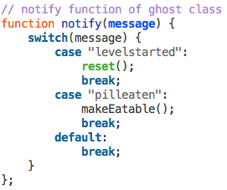
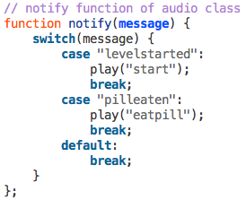
Observer – Pac Man (cont.)
after:

Slide 32
Observer – Pac Man (cont.)
Observable
Observers
Game
subscribe()
Ghost
notify(msg)
startLevel()
notifyObservers(msg=„levelstarted“)
...
eatenPill()
notifyObservers(msg=„pilleaten“)
Audio
subscribe()
notify(msg)

Slide 33
Summary
Advantages of Behavioral Patterns:
Increase flexibility of programs
Well defined communication between objects (e.g. Observer)
Ability to extend programs easily
Simplify complex algorithms and control flows (e.g. Chain of Responsibility)

Slide 34
Sources
http://www.dofactory.com/javascript/design-patterns
https://sourcemaking.com/design_patterns
http://www.blackwasp.co.uk/DesignPatternsArticles.aspx
https://en.wikipedia.org/wiki/Command_pattern
https://de.wikipedia.org/wiki/Memento_%28Entwurfsmuster%29
https://en.wikipedia.org/wiki/Chain-of-responsibility_pattern
Projects
Spaceinvader: https://github.com/dwmkerr/spaceinvaders
Tic Tac Toe: https://github.com/negomi/tic-tac-toe
Pacman: https://github.com/daleharvey/pacman

Slide 35
Thanks for listening
Questions?

Slide 36
Backup slides...

Slide 37
Iterator
access elements without knowing the underlying structure of the object
effectively loop over a object collection
object store as list, trees or more complex structures
many language have build in iterator, but not JavaScript
Iterator is the “secretary”

Slide 38
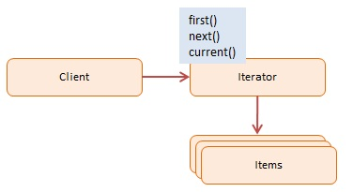
Iterator - Participants
Client: uses the iterator
Iterator: interface with methods like first(), next(), hasNext()
Items: individual objects
http://www.dofactory.com/images/diagrams/javascript/javascript-iterator.jpg

Slide 39
Strategie
Interchangeable set of algorithms
Swapped out at runtime
Minimizing coupling
Option to hide implementation

Slide 40
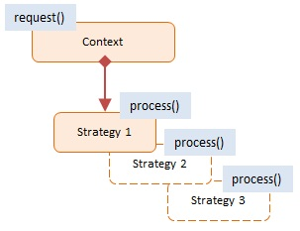
Strategie - Participants
Context: reference to the current Strategy, the option to change it and to calculate the “cost” of each strategy
Strategy: implementation of different option for a task
http://www.dofactory.com/images/diagrams/javascript/javascript-strategy.jpg

Slide 41
Template method
Outline of a series of steps for an algorithm
Subclasses can redefine certain steps of an algorithm without changing the algorithms structure
Offers extensibility to the client developer

Slide 42
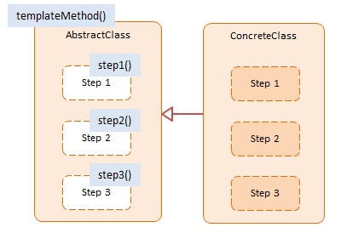
Template method - Participants
AbstractClass: template method defining the primitive steps for an algorithms
ConcreteClass: implements the primitive steps as defined
http://www.dofactory.com/images/diagrams/javascript/javascript-template-method.jpg

Slide 43
State
A object can alter its behaviour when its internal state changes
Object appears to have changed its class
E.g. state machines

Slide 44
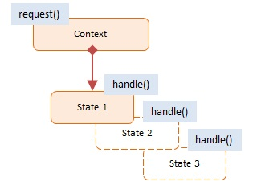
State - Participants
Context: maintains a reference to a object, defines its current state, and allows it to change its state
State: state values are associated with the according behaviour of the state
http://www.dofactory.com/images/diagrams/javascript/javascript-state.jpg

